Slide 1
CLASSES 2^ A-B-C
s. y. 2019/2020
ENGLISH
GEOMETRY: shapes

Slide 2
WATCH THESE FUNNY VIDEOS
‘’SHAPES’’
https://www.youtube.com/watch?v=o-6OKWU99Co
‘’THE GUMBALL MACHINE’’
https://www.youtube.com/watch?v=JGf3oSPPpfM&list=PLVj0Z5FaSe2juBKIlSZwFkYKgBWP02oJH&index=4

Slide 3
…AND NOW WATCH THIS OTHER FUNNY
VIDEO:
listen and repeat
‘’NAME OF SHAPES’’
https://www.youtube.com/watch?v=jbxXG6hwcRk

Slide 4
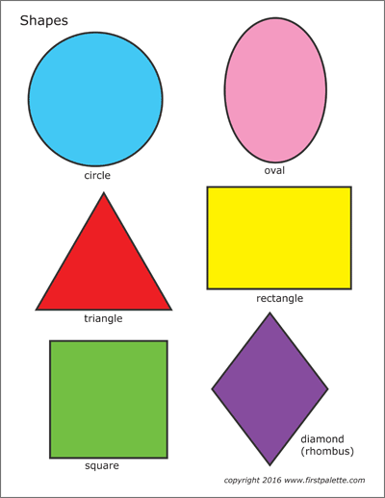
CC
COPY THE SHAPES TO YOUR
EXERCISE BOOK
AND MEMORIZE THE WORDS

Slide 5
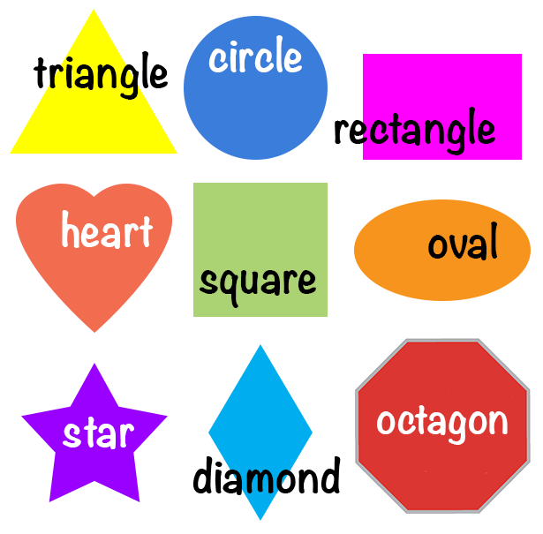
COPY THE SHAPES,
ANOTHER TIME, TO
YOUR EXERCISE BOOK
AND MEMORIZE THE
WORDS

Slide 6
COPY THE PICTURE AND WRITE THE NAME IN EVERY GEOMETRIC FIGURE

Slide 7
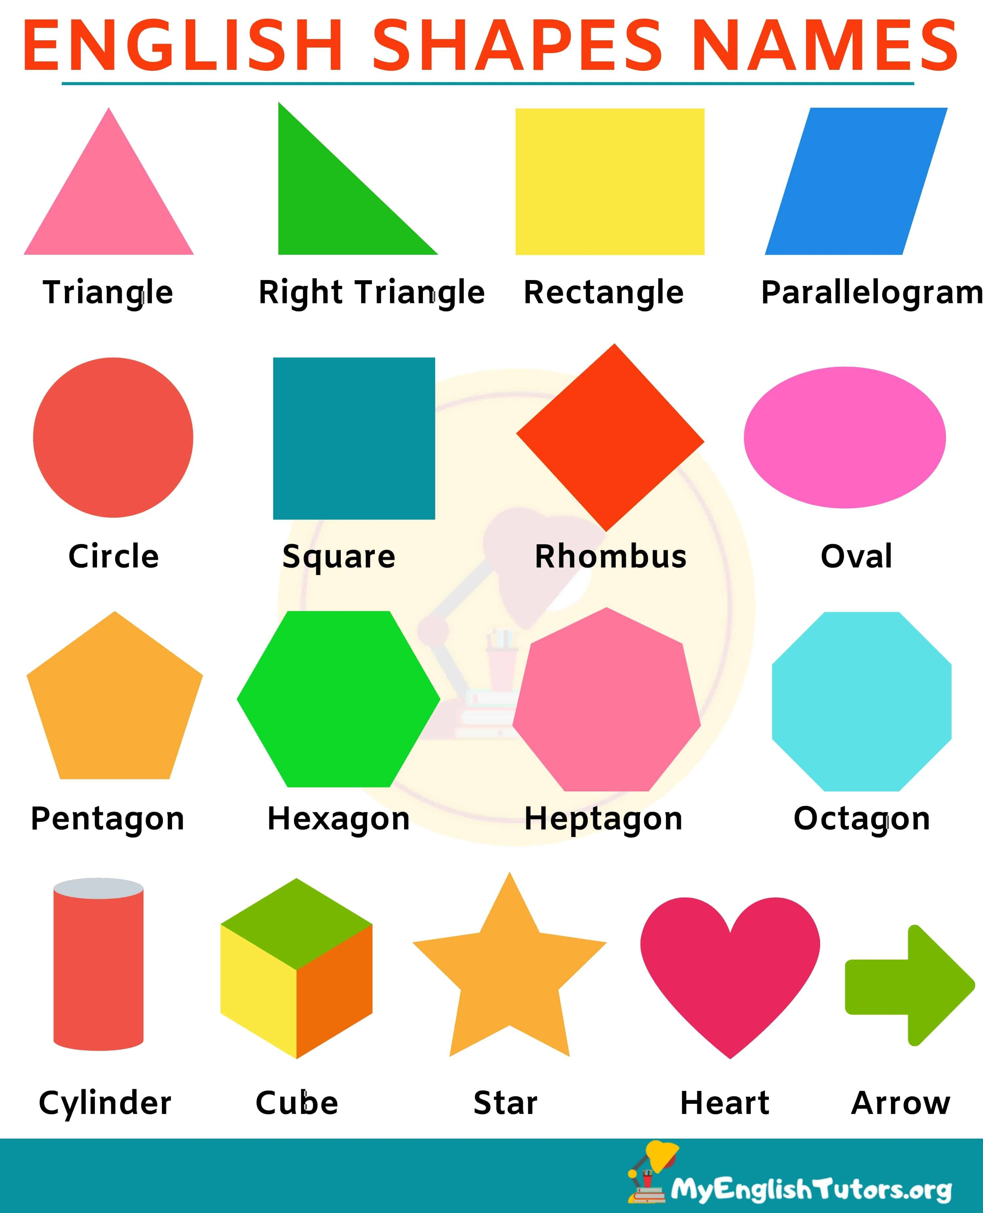

Slide 8
IT’S YOUR TURN, TOO… Copy the words and memorize, then write the plural of all names (remember add the letter ‘’s’’) for example SINGULAR PLURAL triangle triangles right triangle right triangles ………….. …………….

Slide 9
‘’WHAT SHAPE IS IT?’’
Watch the video, listen and repeat
https://www.youtube.com/watch?v=E6qWBhEiP6g&list=PL9FexaiRQNK1NzO1w8UcP2-s4kvsEJMje
Pay attention!!!

Slide 10
Do the interactive exercise
https://www.topmarks.co.uk/ordering-and-sequencing/shape-patterns
http://www.supercoloring.com/it/disegni-da-colorare/forme-geometriche?colore=online
Sing the shapes song
https://www.youtube.com/watch?v=w6eTDfkvPmo
GOOD JOB and HAVE FUN!!!
L L
.

Slide 13
WHAT’S THIS IN YOUR OPINION?
It’s a ……….
Very good!!!

Slide 14
a……
…and now have fun with……………..

Slide 15
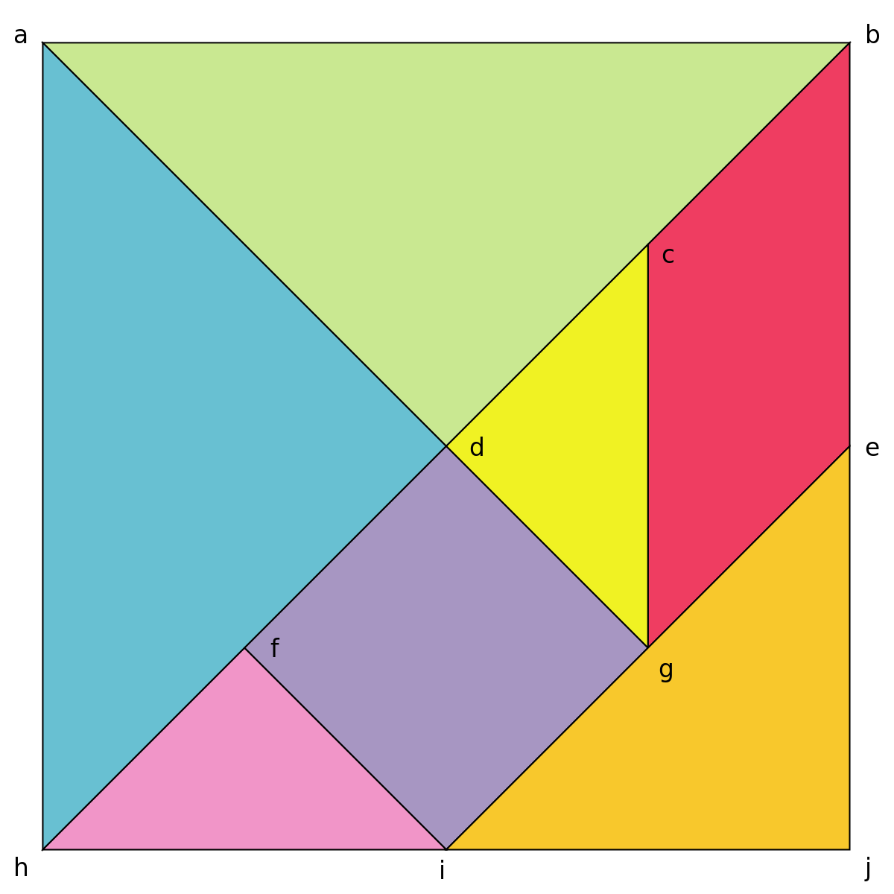
TANGRAM
Chinese geometrical puzzle consisting of a square cut into seven pieces:
2 big triangles
1 medium triangle
2 little triangles
1 square
1 parallelogram

Slide 16
DO YOU WANT
TO BUILD
A TANGRAM?

Slide 17
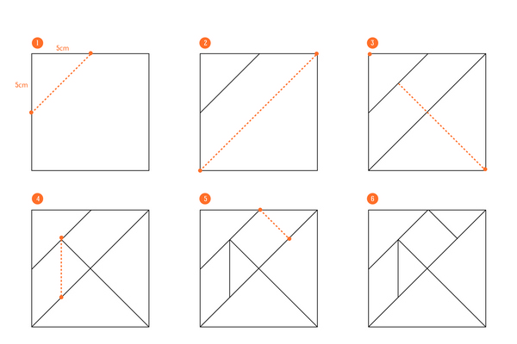
HOW TO MAKE A TANGRAM….
https://www.youtube.com/watch?v=inEC2rTaPgg
https://www.youtube.com/watch?v=R9HGnrmdrEU

Slide 18
HAVE FUN!!! WITH LOVE
WATCH THE VIDEO: ‘’ANIMALS WITH TANGRAM’’
https://www.youtube.com/watch?v=uRwDGQw2JoI
PLAY online: TANGRAM
https://www.navediclo.it/webapp/tangram/tangram.html

